Slide 1
Puberty
Physiology and Pathology

Slide 2
Hypothalamic-Pituitary-Gonadal Axis
hypothalamus
GNRH
Steroidal &
Non-steroidal
Hormones
(negative
Feedbacks)
pituitary
FSH/LH
ovary/testis

Slide 3
Hypothalamic-Pituitary-Gonadal Axis
Fetal
Early infancy
Childhood
Late pre-puberty
Puberty

Slide 4
Hypothalamic-Pituitary-Gonadal Axis
Fetal life:
- hCG peaks at 12 weeks of gestational ag
- GHRH activity is present early and goes on until 20 weeks, when fetoplacental steroids suppress GHRH to term
Testes:
T secretion from 7 weeks, with peak at 15-18 weeks
Ovaries:
minimal oestrogen production, active follicle development
- oocyte population requires 2 active X chromosomes
- anencephalic fetuses have no follicular development, so follicular survival depends on some pituitary activity

Slide 5
Hypothalamic-Pituitary-Gonadal Axis:
2. Early infancy:
GHRH activity is significant from age 2 weeks to 6 months in boys / to 12 months in girls
Testes:
during the first months of life produce significant amounts of testosterone (mini-puberty)
Ovaries:
significant oestrogen production, some follicular development, immature feedback to pituitary so that
FSH may be elevated up to 12 months and sometimes 48 months

Slide 6
Testosterone levels in normal males
Foetus
Early
infancy
Puberty
Adulthood
Late
adulthood
Test
ng/dl
500
2°-4°
month
(mini-
puberty
250
1 2 3
birth

Slide 7
Hypothalamic-Pituitary-Gonadal Axis:
3. Childhood:
The negative feedback matures after 6 months in males, after 12 months in females, with decline in FSH and LH levels
The lowest levels of FSH and LH are present at about 4 years of age
Ovaries: activity increases after 6 years of age

Slide 8
Hypothalamic-Pituitary-Gonadal Axis:
4. Late pre-puberty:
Increasing amplitude and frequency of GnRH pulses
Oestrogens sensitises pituitary to GnRH

Slide 9
Puberty
Nocturnal GRH pulsatility (LH secretion) precedes phenotypic changes
First phenotypic changes:
- breast development in females
- testicular enlargement in males

Slide 10
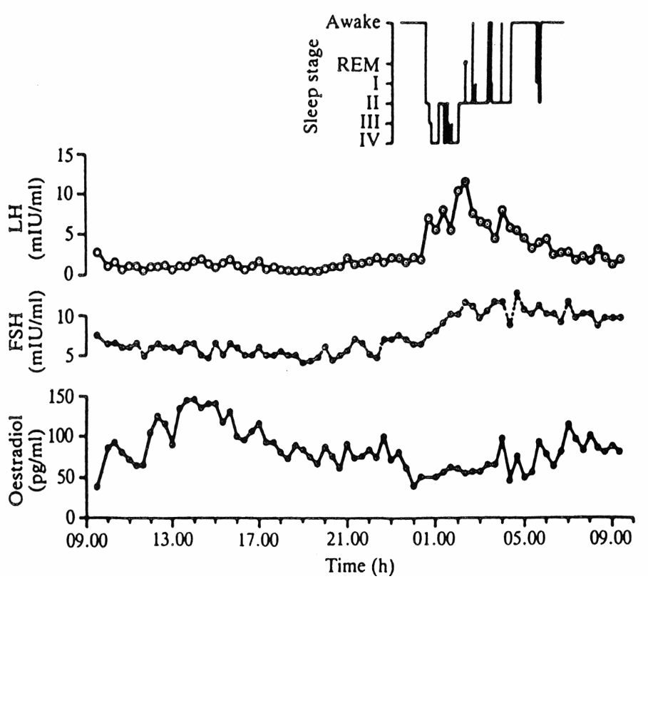
Sleep dependent nocturnal
rise in LH in a girl
From Boyar et al. 1976

Slide 11
Puberty progresses with increase in nocturnal amplitude of LH and gradual change to adult pattern of 90 min pulses, siimilarly in boys and girls.
FSH pulsatility shows no diurnal variation at any stage, with slight increase in amplitude but not frequency as puberty progresses

Slide 12
Hypothalamic-Pituitary-Gonadal Axis:
5. Puberty:
Transition from childhood to adulthood
- Growth acceleration (pubertal growth spurt)
- secondary sexual characteristics appearance and maturation
- fertility
- Boys: muscle mass increase, voice changes
- Girls: breast development, gender related fat distribution

Slide 13
HYPOTHALAMUS
GNRH AND GHRH
PITUITARY
GROWTH
LH & FSH
HORMONE
LIVER
GONADS
INSULIN
SEX STEROID SYNTHESIS
SHBG
IGFBP-1
IGF-1
SEXUAL MATURATION
SOMATIC
GROWTH

Slide 14
Puberty in girls
Secondary sexual characteristics appear in 95% of girls
between 8.5 and 13 years of age
Average age at breast stage 2 = 11.2 years
Pubic hair usually begins 6 months after the start of breast development, although before breasts in 30% of cases, expecially in overweight subjects
Growth spurt happens 6 months - 1 year later the onset of telarche
Menarche happens between 12 and 15 years, as growth spurt wanes
(average age: 13 years)

Slide 15
Puberty in boys
The secondary sexual features are first noted between the ages of 9-14.
Median age at testicular enlargement (> 4 ml): 12 years.
Onset of pubarche a few months later, sometimes before testicular growth (expecially in overweight subjects).
Pubertal growth spurt starts later than in girls and not until genitalia stages 3 – 4.

Slide 16
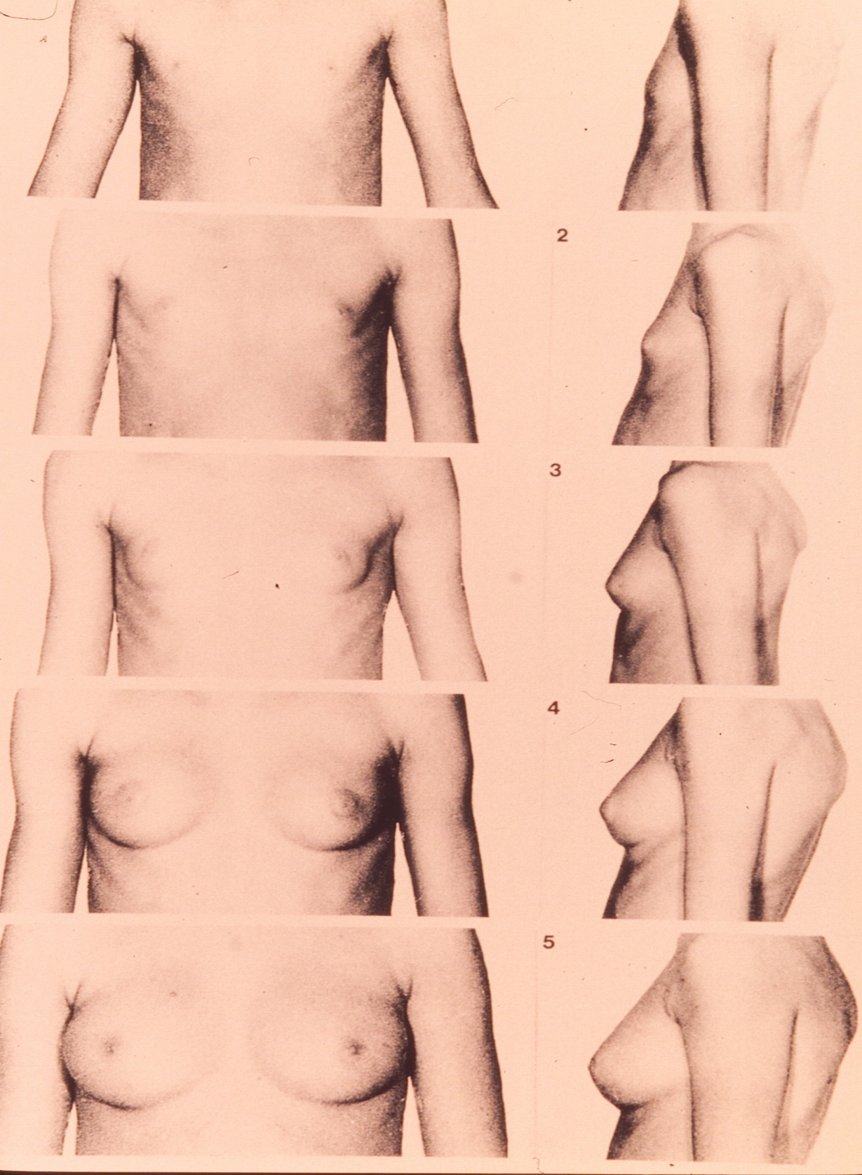
Stages of breast development (Tanner)

Slide 17
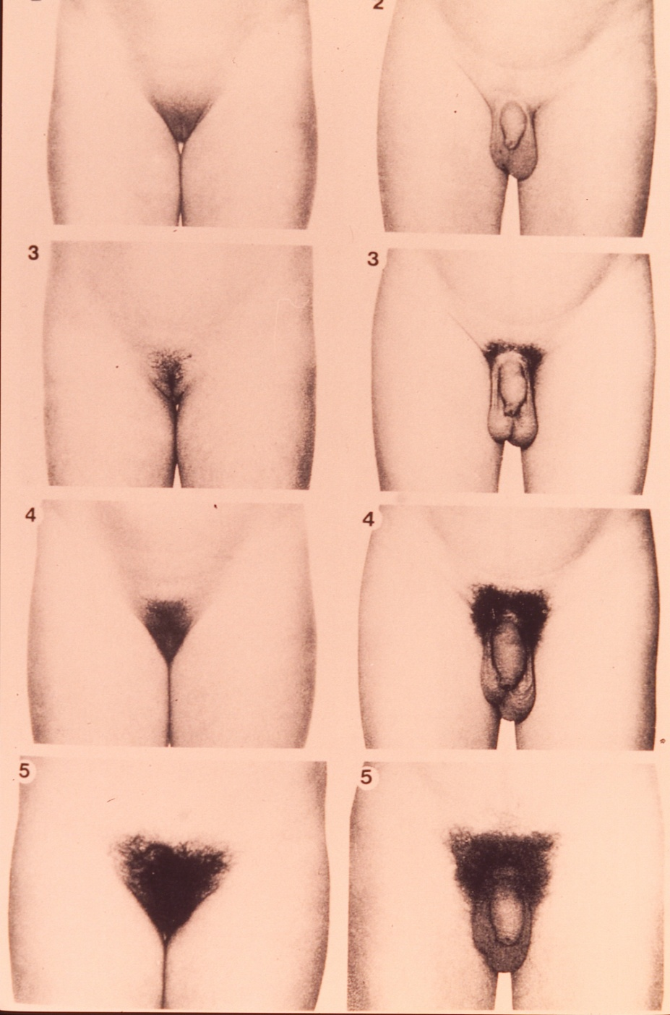
Stages of male and female genital development (Tanner)

Slide 18
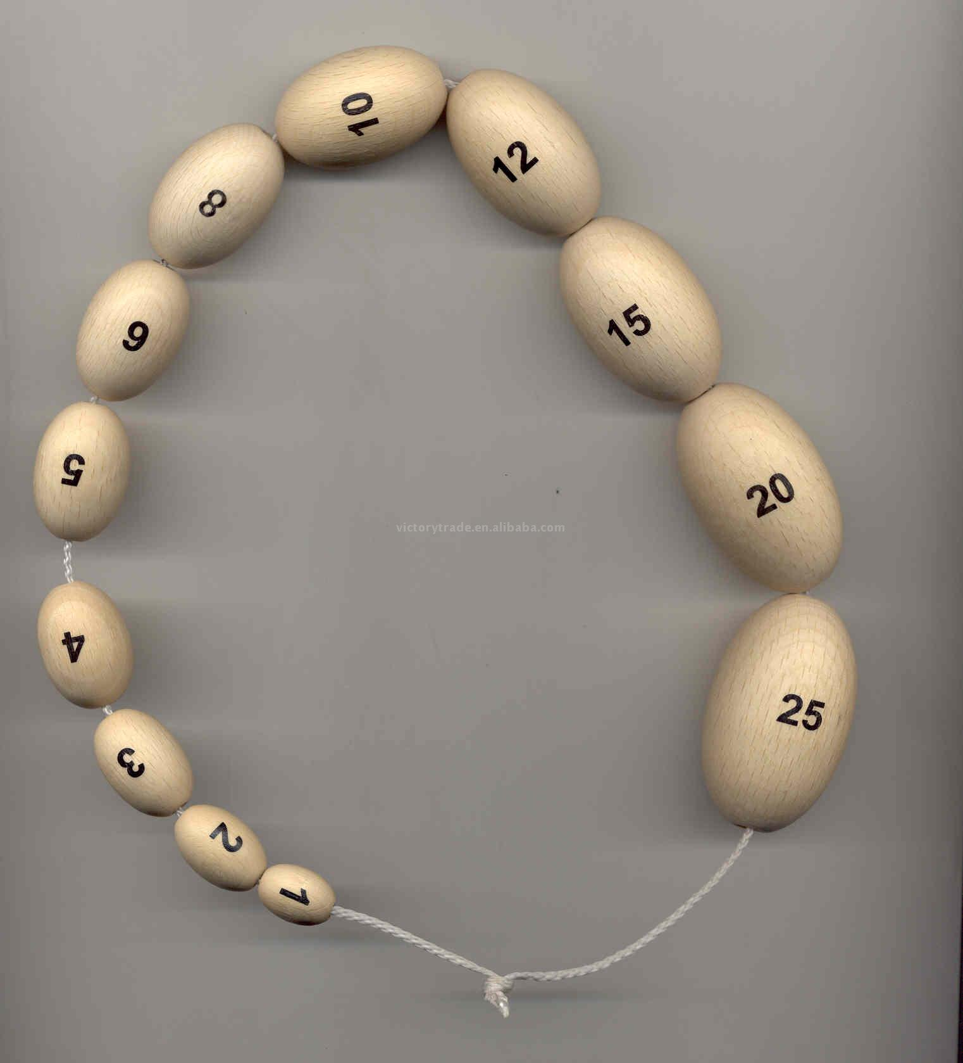
The evaluation of male pubertal status:
Prader’s orchidometer

Slide 19
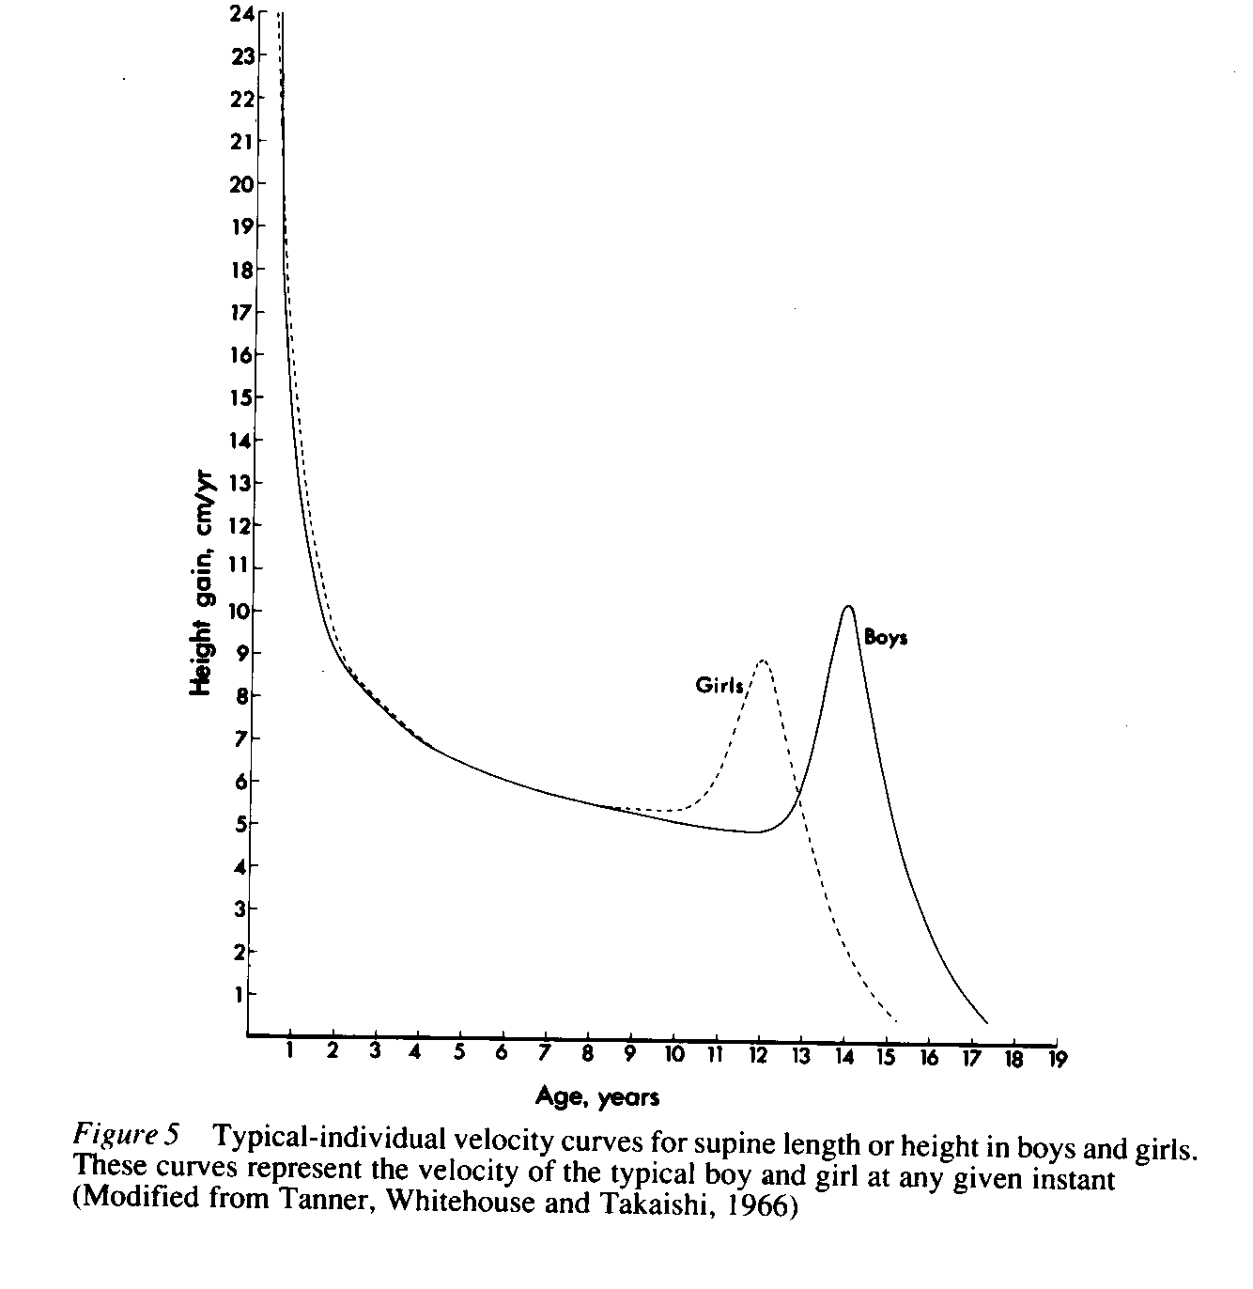
Height velocity growth chart

Slide 20
Progression of Puberty
Usually puberty is completed in 2-3 years
Fastest girls progress through all stages in 18 months
Slowest boys take 5 years

Slide 21
PRECOCIOUS PUBERTY: DEFINITION
Precocious onset of puberty is defined as occurring younger than 2 SD before the average age
Girls <8 years old
Boys <9 years old

Slide 22
PRECOCIOUS PUBERTY:
DIFFERENT TYPES
Gonadotrophin-dependent
(true/central)
Gonadotrophin-independent (peripheral/pseudo)

Slide 23
Gonadotrophin dependent
(“true” or “central” precocious puberty)
Idiopathic (74% of cases, expecially in females)
Family history
More frequent in overweight/obese girls
Adoption from developing countries
Following chronic exposure to sex steroids
Central nervous system disorders
Syndromes (Williams, Silver-Russel, Neurofibromatosis type 1)

Slide 24
Organic causes of gonadotrophin dependent precocious puberty
Intra-cranial lesions (tumours, hydrocephalus, CNS malformations, irradiation, trauma)
Always suspect a tumour in children < 3 years!!!!
Gonadotrophin secreting tumours: germinoma (secreting betahCG)

Slide 25
Variants of central precocious puberty
Premature thelarche:
  Classical (6 months – 2 years of age), continuous with maternal oestrogen
temporary activation of H-P-G axis
Typically FSH levels are higher than LH levels,
breast size is fluctuating
Usually it burns itself out, does not require treatment

Slide 26
Variants of central precocious puberty
Premature thelarche:
  Atypical – older girls
activation of H-P-G axis
fluctuating breast size and occasional menstruation
may progress to central precocious puberty

Slide 27
Variants of central precocious puberty
Premature menarche:
isolated vaginal bleeding with no signs of sexual maturation
Transient mild activation of H-P-G axis
FSH activity is low, oestrogen too low for breast changes
Exclude:
  local lesions genital tract (tumours)
  oestrogen ingestion
  child abuse

Slide 28
Variants of central precocious puberty
Premature adrenarche (or pubarche):
pubic and/or axillary hair < 8 years in females,
< 9 years in males
no other signs of sexual maturation
selective activation of adrenal androgen production
advanced height and bone age
In about 5% of cases it is the first sign of late onset CAH.
may progress to early puberty
in females it is associated with insulin resistance and PCOS

Slide 29
Gonadotrophin-independent causes:
(FSH & LH suppressed)
CAH
McCune-Albright syndrome
  irregular areas of skin pigmentation, polyostotic fibrous dysplasia, ovarian functional cysts due to autonomous ovarian activation (absent nocturnal LH pulses)
Steroid secreting ovarian/adrenal tumours
Oestrogen ingestion

Slide 30
Precocious puberty: diagnosis and management
History
Maternal age at menarche
Familial cases of precocious puberty
Birth weight
Increased height velocity in the previous 6 months-1 year
Accidental exposure to estrogens in females, androgens in males

Slide 31
Precocious puberty: diagnosis and management
Laboratory
LHRH test (gold standard): involving 100 mgc of intravenous gonadotropin-releasing hormone (GNRH), gonadotropin levels are drawn at baseline and 30, 60,90, 120 minutes after the infusion
LH peak > 7-10 UI/l, is considered significant, especially if LH peak is more elevated than FSH peak
Perform also ACTH test, if advanced pubic hair development

Slide 32
Precocious puberty: diagnosis and management
gonadal steroid levels: estradiol> 30 pg/ml in females, testosterone> 40-50 ng/dl in males
pelvic ultrasound in females: the uterus is judged as pubertal in configuration when the body of the uterus is larger than the cervix, with a length > 3.5 cm or a volume > 18 ml, ovarian volume > 2 ml
MRI imaging: to exclude tumours
bone age (wrist): in precocious puberty is usually advanced > 1 yr. It is used to predict potential epiphyseal fusion, and eventually to monitor therapy

